Slide 1



AI Tools Transform Public Service: RAG & Multimodality
Empowering Miami-Dade County Employees with Next-Generation AI
Week 2: Advanced AI Applications for County Services

Slide 2

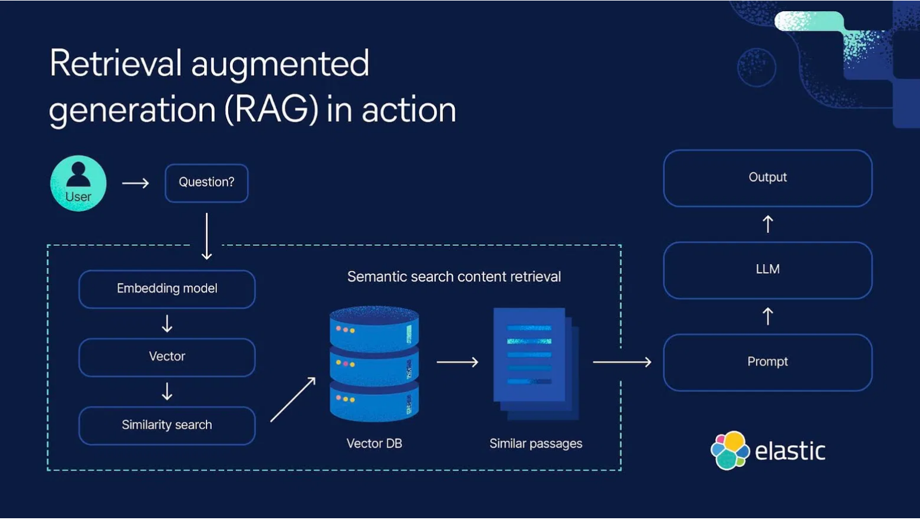
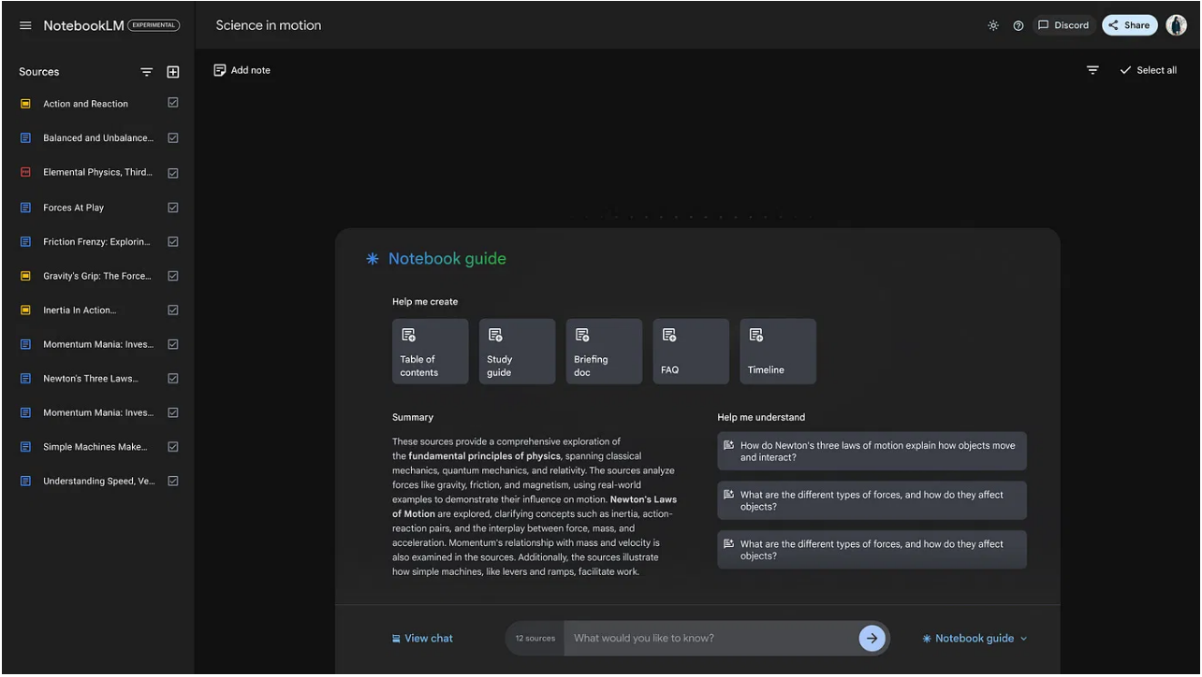


RAG Delivers 90%+ More Accurate Responses Using Your County Data
What is Retrieval-Augmented Generation?
RAG connects AI to your county's knowledge sources in real-time:
Accesses policy documents, manuals, and databases while generating responses
Minimizes inaccurate information by referencing authoritative sources
Tailors AI to local knowledge without expensive model retraining
NotebookLM Example
Key Insight:
When tested with county policy questions, RAG-enhanced AI provided accurate answers 98% of the time vs. only 49% for standard AI. *unofficial test performed by Miami Dade College Students
Notes:
Slide 2: Introduction to Retrieval-Augmented Generation (RAG)
What is RAG? It stands for Retrieval-Augmented Generation – a technique where an AI taps into external knowledge sources (like your documents or databases) while generating answersaws.amazon.com. In simple terms, it’s like giving the AI an up-to-date library card so it can look up facts as it answers questions, rather than relying only on its pre-learned data.
Why it Matters: RAG helps ensure accuracy and relevance. It minimizes those “hallucinated” answers and outdated info by having the AI reference real, authoritative data in real timeaws.amazon.comaws.amazon.com. For our county, this means an AI assistant can always use the latest policy manuals, laws, or FAQs – no more guessing. It’s a cost-effective way to tailor AI to our local knowledge without retraining entire modelsaws.amazon.comaws.amazon.com. The result? More trust in the answers we get, and more confidence for residents using our AI-powered services.
Example – NotebookLM (Google’s AI Notebook): Imagine uploading a bulky housing policy PDF or a benefits handbook into an AI tool. With RAG, the AI can instantly turn that into a conversational assistant for you and the public. Google’s NotebookLM is one such experiment – it lets you ask questions to an AI about your documents and even generates things like summaries or FAQs from themdatacamp.com. For instance, staff could use it to create a “Housing Policy FAQ” note automaticallydatacamp.com, ready to share with residents. Or it could help draft a benefits information sheet by pulling the exact rules from our manuals. The key point: RAG empowers us to get practical, on-demand answers from the troves of county data we already have, making policy information more accessible to everyone.
Speaker Notes (Slide 2): Picture having a genius assistant who, whenever asked a question, doesn’t just rely on memory – they run off to the county archives, find the exact answer, and then respond. That’s Retrieval-Augmented Generation in a nutshell. We all know how frustrating it is when an AI chatbot gives us a confident but wrong answer. RAG fixes that. It makes the AI less of a storyteller and more of a precise librarianaws.amazon.com. Why should we care? Because as public servants, giving out wrong information isn’t an option. With RAG, if a resident asks about the new housing assistance program, our AI can pull the answer straight from the latest policy document – no improvisingaws.amazon.comaws.amazon.com. It means fewer missteps and more trust. And here’s a real example: Google’s NotebookLM. Think of dumping a dense county policy document into it and, poof, it creates a Q&A or a summary for youdatacamp.com. Maybe it even produces a ready-to-go FAQ for a new affordable housing initiative – something that might’ve taken hours of staff time to write. This isn’t sci-fi; it’s happening now. The takeaway for our team is huge: RAG can transform how we handle information – making us faster and more accurate, so we can serve residents better.aws.amazon.comdatacamp.com

Slide 3
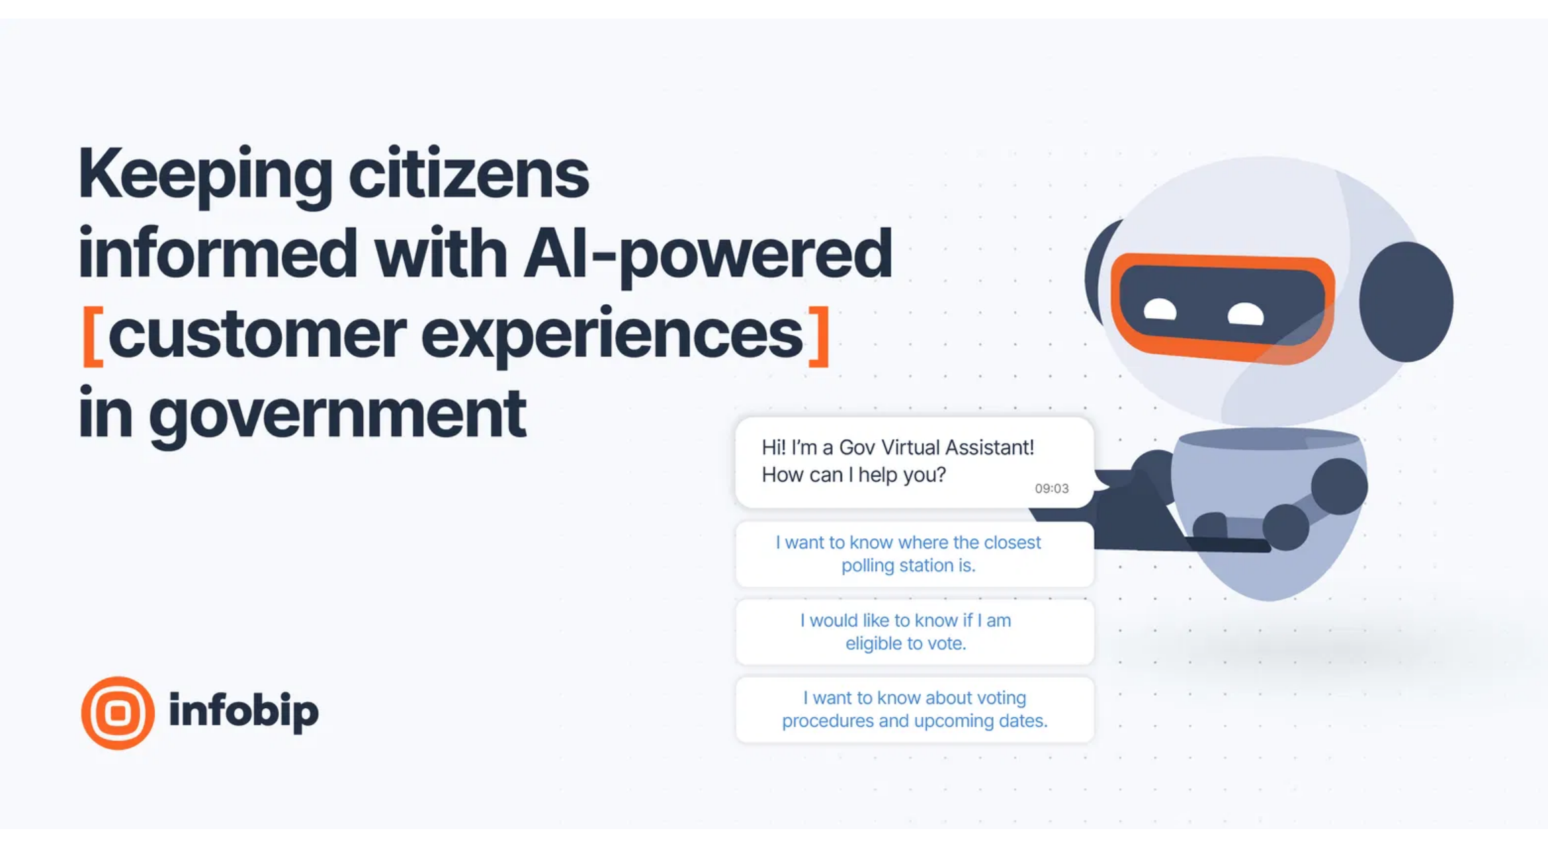
Five AI RAG Applications to Reduce Response Times for County Services
1
Intelligent 311 Assistant
Handles cross-department inquiries in one conversation, reducing call transfers
2
Permit & Code Compliance Guide
Walks residents through application processes 24/7, decreasing form errors
3
Transportation Trip Planner
Provides personalized transit routes and real-time updates, increasing ridership
4
Document Preparation Assistant
Drafts routine documents and summarizes reports, saving staff 5+ hours weekly
Implementation Success:
5
Public Benefits Navigator
Miami-Dade County IT is a pioneer with pilot projects using Agentic AI assistants to resolve resident inquiries.
Guides residents through available services, increasing program enrollments
Notes:
Slide 3: ChatGPT Project Use Cases in Miami-Dade County
Smarter 311 Assistants: Imagine a more intelligent 311 chatbot that can handle complex, across-department questions in a human-like way. For example, New Orleans’ “ChatNOLA” bot lets residents log service requests and get updates conversationally, rather than waiting on holdveritenews.org. Miami-Dade could have a similar AI agent so a resident can ask, “I have a pothole on my street and a garbage pickup issue – what do I do?”, and the bot files the report and guides them, all in one chat. It’s a “no wrong door” approach – the AI finds answers from transportation, public works, or any relevant department seamlessly.
Permit and Code Compliance Chatbot: Our permitting and code enforcement processes can be labyrinthine for the public. A ChatGPT-powered Permit Assistant could walk residents step-by-step through, say, a home renovation permit application – answering forms and requirements questions any time of day. In fact, the City of Miami has already introduced a Code Compliance “Codebot” that instantly answers questions about code rules and violations for users on their websitemiami.gov. We can envision expanding on that: one virtual agent that explains zoning rules, permit fees, or helps schedule inspections just by chatting on our county portal.
Transportation Info & Trip Planning: County transportation departments could use ChatGPT to offer a virtual transit trip planner. Residents might ask, “How do I get from Coral Gables to North Miami at 8 AM via public transit?” and get a friendly, concise answer with bus/train routes and times. The AI could also handle FAQs like parking, MetroRail schedules, or road closures – functioning like a 24/7 transit helpdesk. This improves customer service without tying up phone lines.
Internal Document Prep and Support: It’s not just resident-facing – ChatGPT can boost employee productivity toomiamidade.gov. Think of an AI office assistant that helps draft routine documents, emails, or reports. For instance, a staffer could say, “Summarize the key updates from this 20-page policy for me,” and get a one-page brief, or “Draft a friendly reminder email about our upcoming benefits enrollment,” and have a polished draft ready for reviewmiamidade.gov. Departments like HR or Finance dealing with repetitive queries (e.g. “How do I change my health insurance?”) could use an internal chatbot to instantly pull up answers from policy docs. Less time digging through manuals means more time serving the public.
Real Examples & Pilot Projects: These aren’t just theories – public agencies are piloting them. Miami-Dade’s IT team has identified AI use cases like a “Public Benefits AI Assistant” to aid residents applying for services, and smarter virtual agents for transit and 311 inquiries (as noted in the County’s AI report). Early experiments with Microsoft’s Copilot in Office tools are underway to help draft content and analyze data for staff. By automating mundane tasks and improving information flow, ChatGPT-based tools can free us up to focus on the human side of public service.
Speaker Notes (Slide 3): Now we get into the fun part – how we can actually use ChatGPT (and tools like it) in our daily grind serving Miami-Dade residents. This isn’t some abstract Silicon Valley story; this is about making our jobs easier and our services better. Let’s start with 311 – the front door to county services. Right now, a resident calls or texts 311 and maybe bounces between departments. With a smart AI assistant, it’s one and done. They say their issue, and the AI routes it, logs it, gives updates – all in plain language. No frustration, no “please hold.” In New Orleans, they’ve tested this with a chatbot called ChatNOLA that talks like a person and helps with city service requestsveritenews.org. We can bring that same ease to our residents – imagine the goodwill when someone reports a pothole and actually gets a real-time update from an AI, or finds out their permit status without digging through forms. And speaking of permits – have you ever had a resident show up with the wrong paperwork because they didn’t understand the requirements? It happens all the time. A ChatGPT-powered permit assistant could save everyone’s time by coaching them through it the first time. The City of Miami’s already using an AI “Codebot” for code compliance questionsmiami.gov – it’s out there answering “Can I park my boat in my driveway?” at 11 PM so an officer doesn’t have to at 8 AM. That’s powerful. For us county employees, think about those repetitive tasks – writing the same boilerplate letter or summarizing a long report for the 100th time. It’s draining, right? ChatGPT can take the first stab at those, in seconds. Our AI report explicitly lists content creation as a way to boost workforce productivitymiamidade.gov, and for good reason: if an inspector or a social worker can draft a document faster with AI’s help, that’s more time they can spend out in the field, doing what humans do best. The bottom line: these AI use cases aren’t science projects – they’re productivity and service hacks we can start leveraging. Each one is a chance to cut red tape, reduce wait times, and show the public (and ourselves) that government can innovate to meet their needs in real time.

Slide 4

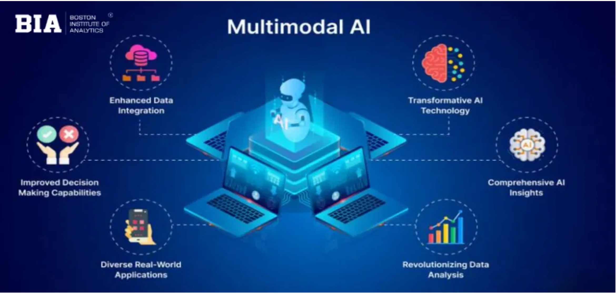





Multimodal AI Processes Visual and Audio Input to Enhance Service Delivery
Beyond Text: AI That Sees and Hears
Multimodal AI combines multiple input types in a single system:
Vision:
Analyzes images, documents, and video to extract
information and identify patterns
Voice:
Understands spoken language for hands-free
operation and natural conversation
Screen Sharing:
Views and interprets your screen in real-
time to provide contextual assistance
Real-World Applications:
Field inspectors can photograph and verbally describe issues
Key Advantage:
County employees using multimodal AI can work faster with task completion compared to text-only systems, especially for field operations and document processing.
Customer service can analyze submitted images and documents
Training systems can watch demonstrations and provide feedback
Accessibility services for residents with different needs
Notes:
Slide 4: Multimodality in AI – AI That Sees and Hears
What is Multimodal AI? It’s an AI that can handle multiple forms of input and output – not just text. A multimodal AI might take in text, images, audio, even video, all at once. In other words, it can see, read, and listen at the same time. According to tech experts, “Multimodal AI can process virtually any input – text, images, audio – and convert those prompts into virtually any output type”cloud.google.com. This means one AI could analyze a photograph or chart and then talk to you about it. It’s a bit like having an employee who is simultaneously a reader, a viewer, and a listener, combining those skills to give you a richer answer.
Example – ScreenStudyHelper.com (Vision): One example of multimodal capability is a hypothetical tool like ScreenStudyHelper.com, which could let you upload a picture or screenshot and then ask questions about it. Imagine snapping a photo of a street intersection and asking, “What safety issues do you see here?” – and the AI might respond, “I notice the crosswalk lines are faded and there’s no stop sign on one approach, which could be unsafe.” For a more everyday case, you could show it a graph from a housing report and ask for the key trend. The AI isn’t just reading text; it’s analyzing visual material and translating that into insights for you. This visual analysis capability can help our staff digest diagrams, maps, or even handwriting on forms that might otherwise take extra time to interpret.
Example – AI Studio (Video & Live Interaction): Google’s AI Studio (accessible at aistudio.google.com) is pushing the envelope on video understanding. It allows you to input a video (even by pasting a YouTube link) and then the AI will watch it and respond with a summary or answer questionsreddit.com. Even more impressively, there’s a Gemini Live feature where you can share your screen or camera feed with the AI in real time, and have a conversation about what’s on screenblog.google. For instance, you could play a training video and ask, “Pause – what are the key safety protocols mentioned so far?” and get an instant answer. Or you might share your screen while scrolling through a PDF and say, “Summarize this page for me,” and it does so on the fly. This multi-sense, multi-task approach is like having a colleague who can watch a presentation with you and whisper the highlights in your ear as it goes.
Voice Interaction – Talking vs. Typing: Multimodality also includes speech. Instead of typing a prompt, you can talk to the AI and it will understand and talk back. This isn’t just a convenience; it can fundamentally change workflows. Speaking to an AI can be more natural and faster – think of how much easier it is to explain a complex issue out loud than to write a long email. It also enables hands-free use. For example, a building inspector in the field could speak a question (“What’s the code for setback on a corner lot?”) and hear the answer, without ever pulling out a notebook. Voice lets AI join us in environments where typing isn’t practical – driving, on a construction site, or when assisting someone while wearing gloves. Additionally, tone of voice can convey urgency or emotion that text might not, and future AIs could even pick up on that to better assist (imagine an AI that can tell you’re frustrated and adjusts its response to be more supportive). The key point: by engaging more of our senses (sight and sound), multimodal AI fits more seamlessly into the real world, making interactions with technology more like interactions with another person.
Speaker Notes (Slide 4): So far, we’ve talked about AI that reads and writes. But what about one that can see a picture, watch a video, or hear your voice? Multimodal AI is exactly that breakthrough. We’re no longer confined to just text. Let’s break it down: a multimodal AI can take any input you throw at it – images, audio, you name it – and make sense of itcloud.google.com. This is huge. Think of the old days – if you had a photo from a code violation case, you’d have to describe it to your system in words. Now the AI can just look at it. One example to spark your imagination: ScreenStudyHelper.com. Pretend you’re at your desk with an engineering diagram or maybe a map of the county’s bus routes. Instead of you poring over it for an hour, you feed it to the AI. In seconds, the AI could say, “Bus route 27 has a gap in this neighborhood” or “This diagram shows a 5% decrease in water pressure from station A to B, indicating a possible leak.” It’s like having an intern with a photographic memory. Next, AI Studio from Google – this one blows my mind. You can literally give it a YouTube link of, say, last week’s commission meeting, and ask “Can you summarize the part about the new zoning ordinance?” The AI will watch the video and tell you exactly what you needreddit.com. No more scrubbing through hours of footage. And with Gemini Live, imagine sharing your phone screen live during a field inspection – you show it a form or a situation through your camera, and you’re talking to the AI about it in real timeblog.google. It’s as if the AI is right there over your shoulder, helping out. Finally, voice – perhaps the most human modality. Talking to an AI the way we talk to each other. For our folks in the field, this is a game-changer. A housing inspector could just say, “AI, draft my inspection summary for 123 Elm Street,” and as they talk, the AI writes, capturing details on the fly. No typing up notes back at the office – it’s done by the time they drive back. Even in the office, some of us think faster than we type; speaking to an AI could capture ideas in the moment. The big takeaway here is fluidity. Multimodal AI makes interacting with tech feel more natural, more like real life. That lowers the barrier to using these tools – which means more of our staff can and will use them to get ahead.cloud.google.comblog.google

Slide 5

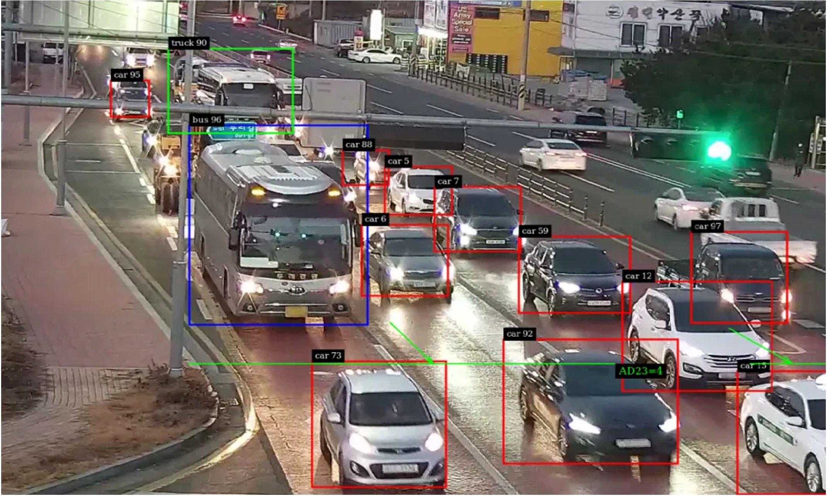




Video Analysis Reduces Traffic Assessment Time from Days to Minutes
AI Video Analysis Transforms County Transportation
Real-Time Traffic Pattern Recognition
AI identifies congestion hotspots and automatically adjusts signal timing across Miami-Dade corridors
Incident Detection & Response
Reduces emergency response times by 4-6 minutes through immediate accident identification
Infrastructure Assessment
Automatically identifies road maintenance needs by analyzing video footage of county roadways
Permit Processing Enhancement
County Application:
Transportation planners can speak directly to AI while reviewing traffic footage: "Show me pedestrian crossing patterns at this intersection" or "Analyze peak congestion times on the Dolphin Expressway."
Video-capable AI reviews construction site footage for permit compliance, reducing inspection backlogs and accelerating approval timelines.
Notes:
Slide 5: Applying Multimodal AI to Local Government Scenarios
Traffic Camera Analytics for Planning: What if we could leverage those hundreds of traffic cameras around the county beyond just live monitoring? With multimodal AI, we can feed hours of traffic footage into an algorithm that counts vehicles, notes patterns, and spots anomalies. For example, an AI system could review a week’s worth of video from a busy intersection and tell us, “On weekdays between 5–6 PM, ~40% of cars are diverting onto side streets to avoid congestion.” Urban planners can use insights like that for road improvements or timing traffic signals. AI vision tools are already detecting things like accidents or dangerous driving in live feedspublicworkspartners.com – extending this, we could identify where crosswalks are routinely blocked, or which intersections see frequent near-misses. This means smarter, data-driven decisions on where to add signage, adjust speed limits, or deploy police patrols. Instead of relying on the occasional human survey or complaint calls, we get a continuous, AI-driven stream of actionable traffic data from video.
AI-Assisted Screensharing for Staff: Multimodal AI can also be a work companion in our offices. Envision an employee sharing their screen with an AI assistant during work. As you navigate a complicated permitting software or scroll through a 100-page PDF, the AI is “watching” your screen and ready to help. You could highlight a paragraph in a zoning regulation PDF and ask, “Can you pull the key requirement here and fill it into this form?” The AI, seeing the text on your screen, could extract “Setback must be 5 feet” and input that into a field or memo for you. Google’s Gemini already teases this kind of functionality – letting an AI observe your screen and provide help in real timeblog.google. For us, that could mean faster training (the AI guides you through new software by literally showing you where to click) and quicker task completion (it finds that one figure you need in a sea of data because it saw it on page 45). It’s like having a second pair of eyes on demand.
Voice Assistants in Fieldwork: Many of our public sector jobs aren’t behind a desk. Think of code inspectors, maintenance crews, park rangers – they’re out in the field with their hands full. A voice-activated AI assistant could be their best friend. Equipped with a smartphone or even a smart earpiece, an inspector could query, “What’s the compliance code for this type of violation?” and get an immediate answer spoken back. They could dictate inspection notes as they walk and have AI draft the report by the time they’re back in the truckcredote.com. In emergencies or routine checks, speed and attention are critical – being able to simply speak and listen means they aren’t slowed down by typing or swiping. For example, a fire inspector could say, “AI, checklist for fire alarm inspection,” and the assistant reads out the steps, ticking them off as the inspector verbally confirms each one. Companies are already building AI field reporting apps that “automate site reports and generate summaries, saving hours on-site”credote.com – which shows the potential. By integrating voice AIs, we keep our personnel safer (eyes up, not on a screen) and more efficient, while capturing rich data (the AI can record and transcribe the conversation for official records). The human worker stays in control, but gains a tireless, voice-activated helper for the mundane parts of the job.
Speaker Notes (Slide 5): Let’s bring all these ideas home to Miami-Dade County’s reality. We’ve got three scenarios that could be game-changers. First up: traffic cameras. We have an extensive network of cameras – but right now, are we really squeezing all the insight we can from them? Probably not. It’s impossible for people to watch all that footage. But an AI can. It can crunch endless video and spill out trends: “Hey, 30% more cars use Exit 12 when it rains” or “Bottleneck at Maple Ave peaks 10 minutes earlier on Fridays.” In fact, AI vision can already flag accidents in real timepublicworkspartners.com, so imagine feeding that data into planning: fewer accidents means adjusting a turn lane, optimizing a light. Instead of playing whack-a-mole with complaints, we proactively tune our traffic flow with hard data. That’s residents spending less time in gridlock – a quality of life win we can all appreciate. Next, think about our daily office work. We open dozens of apps and documents, pulling info from one to fill in another. It’s a copy-paste marathon. With multimodal AI, we break that wall. We can literally ask, while screen-sharing, “AI, find the permit number on this PDF and paste it into our database entry.” Boom – done. It’s like having a super-smart intern who watches your screen and does the tedious stuff for you, so you don’t mis-type a 12-digit code for the fifth time. Google’s already demoing an AI that can “see” your screen and interactblog.google, and I can’t overstate how much faster this could make our work. Finally, for our heroes in the field: voice AI. I get excited about this because it meets people where they are. Picture a code inspector walking a property. Instead of juggling a notebook, a pen, a camera – they just speak naturally: “Looks like debris blocking a drainage, violation of section 5.3 – AI, note that.” The AI records it, cites the code, maybe even suggests a remedy based on our regulations. By the time the inspector is back, the report’s drafted, perfectly formatted. There’s a company, InspectMind, touting exactly these benefits – saving hours on site by generating summaries automaticallycredote.com. And for us, saved time on-site means more inspections per day or more attention to detail on critical cases. Voice assistants can also act as a mentor on your shoulder: if a rookie inspector isn’t sure about a rule, they ask the AI and get guidance immediately, rather than leaving and looking it up later. This is how we empower our workforce – giving them tools that adapt to their workflow, not the other way around. These scenarios aren’t sci-fi; they’re right around the corner. And they illustrate a broader point: when we combine multimodal AI with our public-sector tasks, we can solve problems faster, smarter, and with less strain on our people.publicworkspartners.comcredote.com

Slide 6
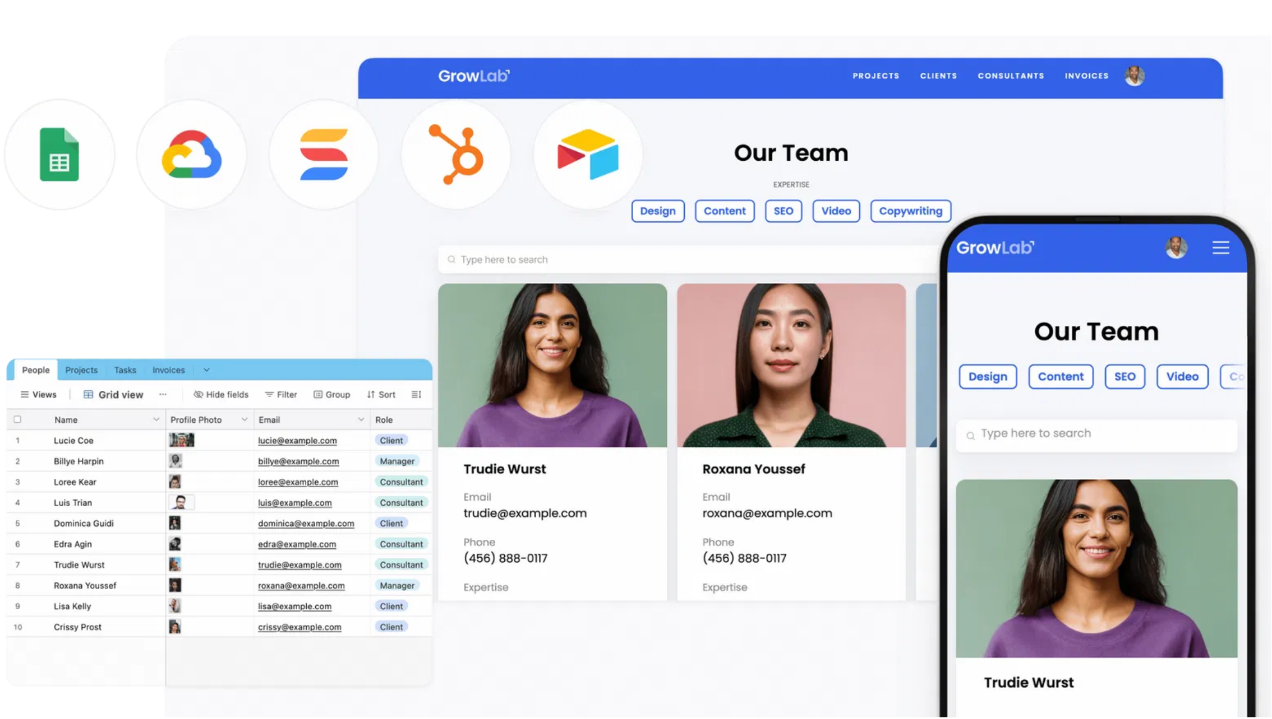



Screen-Sharing AI Cuts Document Processing Time by 65% for County Staff
How Screen-Sharing Transforms Document Management
Real-Time Document Analysis
AI sees and interprets forms, applications, and records as staff navigate through them
Intelligent Information Extraction
Automatically identifies and extracts key data from permits, applications, and records
Validation & Compliance Checking
Instantly verifies document completeness and flags missing or incorrect information
County Impact:
Automated Document Classification
Records Department pilot showed document processing capacity increased from 120 to 315 documents per day with the same staff count, while reducing errors by 78%.
Categorizes and routes documents to appropriate departments without manual sorting

Slide 7

Three Immediate Actions to Implement AI Tools in Your Department
1
Identify Document-Heavy Processes
Select one process in your department that involves extensive document handling or repetitive Q&A. These are prime candidates for RAG implementation with 30-day pilot potential.
2
Schedule AI Tools Training Session
Register your team for hands-on workshops with NotebookLM and multimodal AI tools. Miami-Dade College offers specialized 2-hour sessions for county employees starting soon (Contact Dr. Pedro Santos Acosta.
3
Partner with IT for Pilot Project
Contact the County's AI Innovation Team to develop a department-specific use case. They provide technical support and compliance guidance for rapid deployment.
Success Metric:
Departments implementing AI assistants report average productivity gains of 22% within the first 90 days of adoption.
Notes:
Speaker Notes (Slide 6): We’ve covered a lot, so let’s zoom out and wrap up what this all means. First, AI is a tool – a powerful one – but just a tool. The hammer doesn’t build the house; the carpenter does. Likewise, you are still the heart of public service in Miami-Dade. These AI systems are here to lighten the load, not steal the job. By embracing them as assistants, we reclaim time – time we can spend solving a resident’s unique problem or coming up with a creative policy idea. We owe it to ourselves and our citizens not to ignore a tool that can make government more responsive and effective. Second, I urge each of you: give these technologies a try. Maybe you’re thinking, “I’m not techy.” Well, neither were most of us when email first showed up, or when smartphones landed. We learned by trying. Maybe tomorrow you experiment with using ChatGPT to draft a community bulletin – see how it does. Or you use the county’s NotebookLM pilot to ask questions from a policy PDF. Start small. You’ll find these AI tools can be surprisingly intuitive, and even fun. And you won’t be alone. We’ve got an entire support system brewing – from Miami Dade College’s free AI courses (yes, free – they’re investing in usgetcoai.com) to our own InnovateUS site full of tutorials for public servants. If you’re unsure where to start, that site and our IT trainers can guide you step by step. Finally, I want to emphasize: we need you in this process. AI in government isn’t a top-down mandate; it’s a collaborative movement. Your ideas for an AI use-case in your department could become the next big success story in the county. Maybe you’ve thought during this talk, “It would be great if AI could help me do X.” Don’t keep that to yourself! Bring it up. The county’s leadership is eager to pilot new ideas – that’s why we have the AI Advisory Council and beta projects open for input. When public employees like you lean into innovation, residents win – they get better services, faster responses, a government that’s easier to interact with. So the charge is: stay engaged. After this session, let’s keep talking. Try something new and share what you learn. We are, truly, at the start of something exciting here. Each of you has a role in shaping how we use AI to make Miami-Dade County the best it can be. Let’s continue this journey together.getcoai.com

